Slide 1
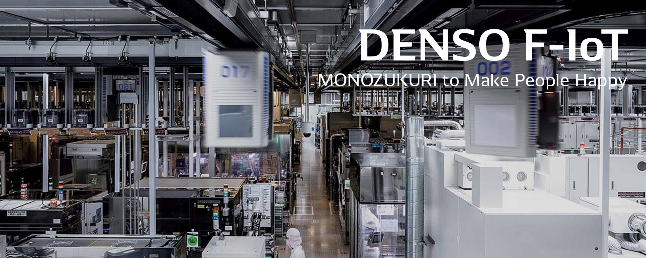

E-PCR
Log In

Slide 2
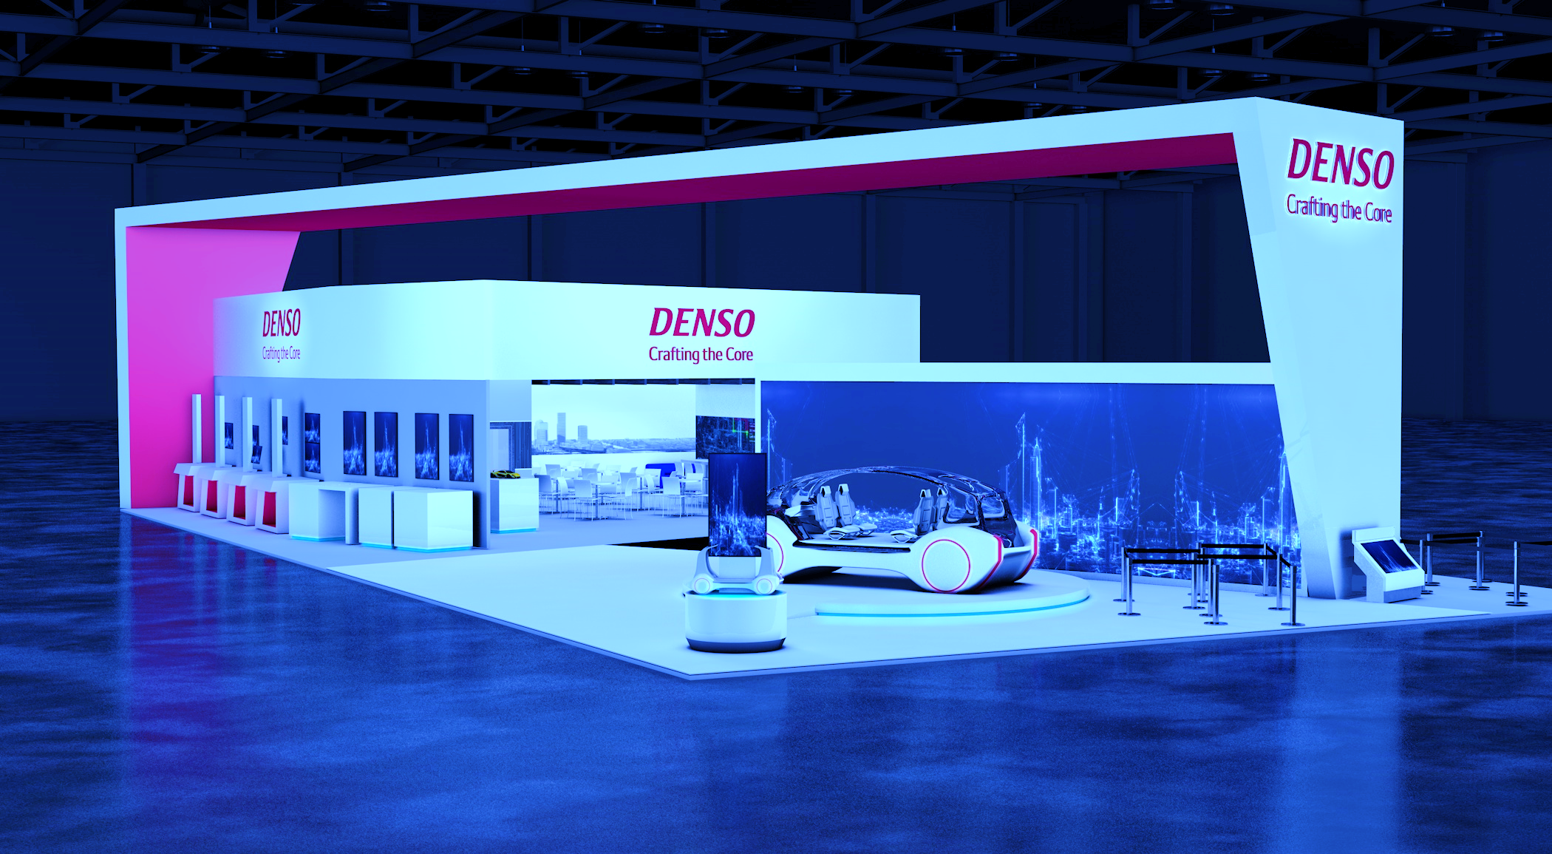

E-PCR
Log In

Slide 3
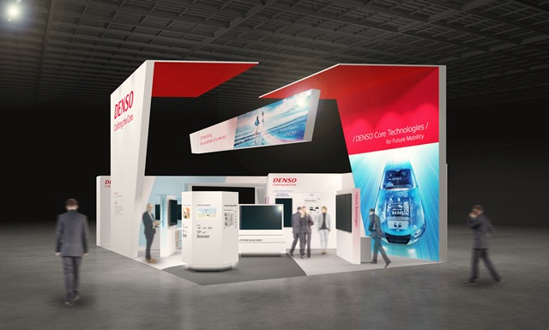
E-PCR
Log In

Slide 4

Username
Password
E-PCR
Remember me
Login
Forgot Password / ID Employee ?
Log In
Log In

Slide 5
Username
Password
E-PCR
Remember me
Login
Forgot Password / ID Employee ?
Log In

Slide 6
Username
Password
E-PCR
Remember me
Login
Forgot Password / ID Employee ?
Log In

Slide 7


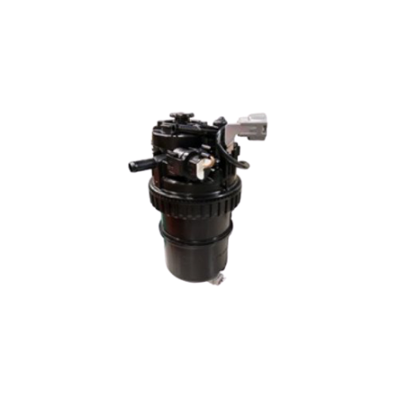


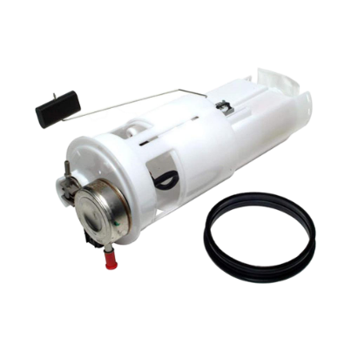
Process Change Report System
Change Process
Approval
Report
Operation manual
SDM
SKD
SUPPLIER

Slide 8





Process Change Report System
Change Process
Approval
Report
Operation manual
USER
Change Process
Process
Show
10
entires
Search :
No
Product name
Title
Rank
Customer submission
PIC
Leadtime
Status
Date
Action
1
xxxxxx
xxxx
x
xxxx
x
Normal
On plan
22/06/62
2
xxxxxx
xxxx
x
xxxx
x
Normal
Reject
13/07/62
3
xxxxxx
xxxx
x
xxxx
x
Urgent
Complete
18/07/62

Slide 9

Process Change Report System
Approval
Report
Operation manual
Change Process
Approval
USER
STEP 1
STEP 2
STEP 3
Readtime :
Normal
Urgent
Create Date :
22/07/2020
Annual Plan :
Annual Plan item
Additional item
Annual Plan No :
xxxxxxxx
Department / Section :
Production Engineer
Registant :
MS.Kittiya Yangsao
No.(Automatic) :
PCR-DPE-FYXX-AXXX
Title :
xxxxxxxx
Judgement Rank :
xxxxxxxx
Change type :
xxxxxxxx
Customer submission:
Yes
No
Customer name:
xxxxxxxx
Planning review:
Yes
No
NEXT

Slide 10
Process Change Report System
Approval
Report
Operation manual
Change Process
Approval
USER
sds
STEP 1
STEP 2
STEP 3
Details of Change
Product :
HP5S
Supplier/Process :
(Only PCR Supplier)
xxxxxxxx
Internal process :
xxxxxxxx
Change point :
xxxxxxxx
Output :
xxxxxxxx
Parts name:
xxxxxxxx
SC Point *:
S
F
E
C
Parts number:
xxxxxxxx
S
F
E
C
S
F
E
C
Other
( )
PREVIOUS
NEXT

Slide 11
Process Change Report System
Approval
Report
Operation manual
Change Process
Approval
USER
sds
STEP 1
STEP 2
STEP 3
Details of Change
Product :
HP5S
Supplier/Process :
(Only PCR Supplier)
xxxxxxxx
Internal process :
xxxxxxxx
Change point :
xxxxxxxx
Output :
xxxxxxxx
Parts name:
xxxxxxxx
SC Point *:
S
F
E
C
Parts number:
xxxxxxxx
S
F
E
C
S
F
E
C
Other
( )
PREVIOUS
NEXT

Slide 12

Process Change Report System
Approval
Report
Operation manual
Change Process
Approval
USER
STEP 1
STEP 2
STEP 3
Details of Process Change : Plan
Existing Process | Proposed Process | Characeristics values affected/Remark
PREVIOUS
NEXT

Slide 13
Process Change Report System
Change Process
Approval
Report
Operation manual
USER
STEP 1
STEP 2
STEP 3
Details of Process Change : Plan
Upload File/Image !!!
Existing Process | Proposed Process | Characeristics values affected/Remark
CLOSE
PREVIOUS
NEXT

Slide 14
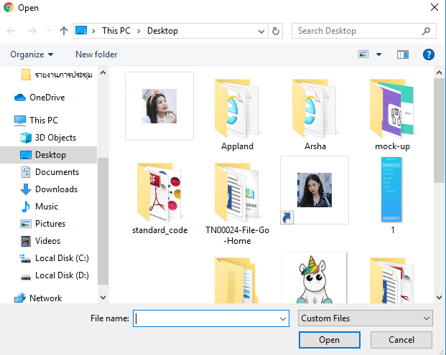
Process Change Report System
Approval
Report
Operation manual
Change Process
Approval
USER
STEP 1
STEP 2
STEP 3
Details of Process Change : Plan
Existing Process | Proposed Process | Characeristics values affected/Remark
PREVIOUS
NEXT

Slide 15
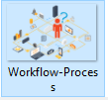
Process Change Report System
Approval
Report
Operation manual
Change Process
Approval
USER
STEP 1
STEP 2
STEP 3
Details of Process Change : Plan
Existing Process | Proposed Process | Characeristics values affected/Remark
PREVIOUS
NEXT

Slide 16

Process Change Report System
Approval
Report
Operation manual
Change Process
Approval
USER
STEP 1
STEP 2
STEP 3
Details of Process Change : Plan
Existing Process | Proposed Process | Characeristics values affected/Remark
PREVIOUS
NEXT

Slide 17

Process Change Report System
Approval
Report
Operation manual
Change Process
Approval
USER
STEP 1
STEP 2
STEP 3
Implementation plan :
1 ) Re – organizing processes
Start
Plan :
Actual :
2 ) Surverying process capability
Start
Plan :
Actual :
3 ) Preparing standard document
Start
Plan :
Actual :
PREVIOUS
NEXT

Slide 18
Operation manual
Report
Operation manual
Process Change Report System
Report
Process Change Report System
Approval
Change Process
Approval
Change Process
USER
STEP 1
STEP 2
STEP 3
4 ) PFMEA/QA Network
Yes
No
Start
Plan :
Actual :
5 ) PCC Concerning
Yes
No
Start
Plan :
Actual :
6 ) Production started date
Start
Plan :
Actual :
PREVIOUS
NEXT

Slide 19
Process Change Report System
Approval
Report
Operation manual
Change Process
Approval
USER
STEP 1
STEP 2
STEP 3
7 ) Other;(Safety,Environment,BKD,etc)
Start
Plan :
Actual :
Need attachments :
1 .PFMEA
Doc No. : *
4 .Standardize work, WI
Doc No. : *
2 .QA Network
Doc No. : *
5 . Machine specification
(Change point of machine)
Doc No. : *
3 .Control plan ,PCC
Doc No. : *
6 .Daily check sheet
Doc No. : *
7 .Other
Doc No. : *
PREVIOUS
NEXT

Slide 20

Process Change Report System
Approval
Report
Operation manual
Change Process
Approval
USER
STEP 1
STEP 2
STEP 3
Approve plan :
Prepared :
MS.Kittiya Yangsao
Amount of PE Approver :
PE Approver 1
PE Approver 2
PREVIOUS
SUBMIT
QA Checker :
Date :
QA Approver :
Date :

Slide 21
Process Change Report System
Change Process
Approval
Report
Operation manual
USER
STEP 1
STEP 2
STEP 3
Approve plan :
Prepared :
MS.Kittiya Yangsao
Amount of PE Approver :
Would you like to Submit ?
PE Approver 1
PE Approver 2
YES
NO
PREVIOUS
SUBMIT

Slide 22
Process Change Report System
Approval
Report
Operation manual
Change Process
Approval
USER
Details
Issue No. 111
Readtime :
Normal
Annual Plan No : 21
Department / Section :
Production Engineer
Registant :
MS.Kittiya Yangsao
No.(Automatic) :
PCR-DPE-FYXX-AXXX
Title :
xxxxxxxx
Judgement Rank :
xxxxxxxx
Change type :
xxxxxxxx
Customer submission:
Yes
Customer name:
xxxxxxxx
Planning review:
Yes
Product :
HP3
HP5S
Internal process :
xxxxxxxx
Supplier/Process :
(Only PCR Supplier)
xxxxxxxx
Change point :
xxxxxxxx
Parts name:
xxxxxxxx
Output :
xxxxxxxx
Parts number:
xxxxxxxx
SC Point *:
S

Slide 23

Process Change Report System
Approval
Report
Operation manual
Change Process
Approval
USER
Details
Details of Process Change :
Existing Process | Proposed Process | Characeristics values affected/Remark
1 ) Re – organizing processes
Start
Plan :
22/07/63
2 ) Surverying process capability
Start
Plan :
22/07/63

Slide 24
Process Change Report System
Change Process
Approval
Report
Operation manual
USER
Details
3 ) Preparing standard document
Start
Plan :
22/07/63
4 ) PFMEA/QA Network
Start
Plan :
22/07/63
5 ) PCC Concerning
Start
Plan :
22/07/63
6 ) Production started date
Start
Plan :
22/07/63
7 ) Other;(Safety,Environment,BKD,etc)
Start
Plan :
22/07/63
Need attachments :
1 .PFMEA
Doc No. : 0000000
2 .QA Network
Doc No. : 0000002
Approve plan :
Prepared :
MS.Kittiya Yangsao
PE Approver :
MS.Patcharaporn Intana
PE Approver :
MS.Kanyarat Rodtong
BACK

Slide 25








Process Change Report System
Change Process
Approval
Report
Operation manual
USER
Status On Plan Phase
PCR-DPE-FYXX-AXXX
PE
PE
PE
PD
Kittiya Yangso
Patcharaporn Intana
Kanyarat Rodtong
Thananporn yaowa
10-07-20 09.00
10-07-20 11.00
10-07-20 11.30
13-07-20 09.00
QAC
BKD
QAP
Somporn Rodton
Omegaze Oliton
Somsri Sriripron
14-07-20 16.32
14-07-20 14.00
13-07-20 09.30

Slide 26
Process Change Report System
Change Process
Approval
Report
Operation manual
USER
Status On Actual Phase
PCR-DPE-FYXX-AXXX
PE
PE
PD
QAC
Kanyarat Rodtong
Patcharaporn Intana
Kittiya Yangso
Thananporn yaowa
1-10-20 09.00
16-01-21 09.00
23-02-21 09.00
12-03-21 09.00

Slide 27
Process Change Report System
Change Process
Approval
Report
Operation manual
USER
Approval
Show
10
entires
Search :
No
Product name
Title
Rank
Customer submission
PIC
Leadtime
Status
Date
Action
Not data to display

Slide 28
Process Change Report System
Change Process
Approval
Report
Operation manual
EXPORT EXCEL

Slide 29
Process Change Report System
Change Process
Approval
Report
Operation manual
Operation manual

Slide 30
Process Change Report System
Change Process
Approval
Report
Operation manual
ANNUAL PLAN

Slide 31
Process Change Report System
Approval
Report
Operation manual
Change Process
Approval
STEP 1
STEP 2
STEP 3
Readtime :
Normal
Urgent
Create Date :
22/07/2020
Annual Plan :
Annual Plan item
Additional item
Annual Plan No :
xxxxxxxx
ADD
Department / Section :
Production Engineer
Registant :
MS.Kittiya Yangsao
No.(Automatic) :
PCR-DPE-FYXX-AXXX
Title :
xxxxxxxx
Judgement Rank :
Change type :
Customer submission:
Yes
No
Customer name:
Planning review:
Yes
No
NEXT

Slide 32
Process Change Report System
Approval
Report
Operation manual
Change Process
Approval
Annual Plan
Annual Plan No : ?
Annual Plan No :
PCR-XXXXXXX
Create Date :
22/07/2020
Readtime :
Normal
Urgent
Annual Plan :
Annual Plan item
Additional item
Department / Section :
Production Engineer
Registant :
MS.Kittiya Yangsao
Judgement Rank :
Title :
xxxxxxxx
Customer submission:
Yes
No
Change type :
Planning review:
Yes
No
Customer name:
Product :
HP3
G2S
G4S-i
PCV
SCV
Internal process :
HP5S
G3S
G4.5S-i
PRV
Filter
Parts name:
HP5E
G4S
Rail
Solenoid
Parts number:
GD-P3H
UC
SIFS
Other

Slide 33
Process Change Report System
Approval
Report
Operation manual
Change Process
Approval
USER
Annual Plan
Product :
HP3
G2S
G4S-i
PCV
SCV
Internal process :
HP5S
G3S
G4.5S-i
PRV
Filter
Parts name:
HP5E
G4S
Rail
Solenoid
Parts number:
GD-P3H
UC
SIFS
Other
Supplier/Process :
(Only PCR Supplier)
Change point :
Output :
SUBMIT
CANCLE

Slide 34
Process Change Report System
Change Process
Approval
Report
Operation manual
ANNUAL PLAN

Slide 35
Process Change Report System
Change Process
Approval
Report
Operation manual
USER
Change Process
Process
Show
10
entires
Search :
No
Product name
Title
Rank
Customer submission
PIC
Leadtime
Status
Date
Action
4
xxxxxx
xxxx
x
xxxx
x
Normal
On plan
04/07/63

Slide 36
Process Change Report System
Change Process
Approval
Report
Operation manual
APPROVER
Approval
Show
10
entires
Search :
No
Product name
Title
Rank
Customer submission
PIC
Leadtime
Status
Date
Action
1
xxxxxx
xxxx
x
xxxx
x
Normal
On plan
22/06/62
2
xxxxxx
xxxx
x
xxxx
x
Normal
On plan
13/07/62
3
xxxxxx
xxxx
x
xxxx
x
Urgent
Complete
18/07/62

Slide 37
Process Change Report System
Approval
Report
Operation manual
Change Process
Approval
Details
Issue No. 111
Readtime :
Normal
Annual Plan No : 21
Department / Section :
Production Engineer
Registant :
MS.Kittiya Yangsao
No.(Automatic) :
PCR-DPE-FYXX-AXXX
Title :
xxxxxxxx
Judgement Rank :
xxxxxxxx
Change type :
xxxxxxxx
Customer submission:
Yes
Customer name:
xxxxxxxx
Planning review:
Yes
Product :
HP3
HP5S
Internal process :
xxxxxxxx
Supplier/Process :
(Only PCR Supplier)
xxxxxxxx
Change point :
xxxxxxxx
Parts name:
xxxxxxxx
Output :
xxxxxxxx
Parts number:
xxxxxxxx
SC Point *:
S

Slide 38
Process Change Report System
Approval
Report
Operation manual
Change Process
Approval
Details
Details of Process Change :
Existing Process | Proposed Process | Characeristics values affected/Remark
1 ) Re – organizing processes
Start
Plan :
22/07/63
2 ) Surverying process capability
Start
Plan :
22/07/63

Slide 39
Process Change Report System
Approval
Report
Operation manual
Change Process
Approval
Details
3 ) Preparing standard document
Start
Plan :
22/07/63
4 ) PFMEA/QA Network
Start
Plan :
22/07/63
5 ) PCC Concerning
Start
Plan :
22/07/63
6 ) Production started date
Start
Plan :
22/07/63
7 ) Other;(Safety,Environment,BKD,etc)
Start
Plan :
22/07/63
Need attachments :
1 .PFMEA
Doc No. : 0000000
2 .QA Network
Doc No. : 0000002
Approve plan :
Prepared :
MS.Kittiya Yangsao
PE Approver :
MS.Patcharaporn Intana
PE Approver :
MS.Kanyarat Rodtong
Approve
Not Approve

Slide 40
Process Change Report System
Change Process
Approval
Report
Operation manual
Details
3 ) Preparing standard document
Start
Plan :
22/07/63
4 ) PFMEA/QA Network
Start
Plan :
22/07/63
5 ) PCC Concerning
Start
Plan :
22/07/63
Would you like to Approve ?
6 ) Production started date
Start
Plan :
22/07/63
7 ) Other;(Safety,Environment,BKD,etc)
Start
Plan :
22/07/63
Need attachments :
YES
NO
1 .PFMEA
Doc No. : 0000000
2 .QA Network
Doc No. : 0000002
Approve plan :
Prepared :
MS.Kittiya Yangsao
PE Approver :
MS.Patcharaporn Intana
PE Approver :
MS.Kanyarat Rodtong
Approve
Not Approve

Slide 41
Process Change Report System
Change Process
Approval
Report
Operation manual
Details
3 ) Preparing standard document
Start
Plan :
22/07/63
Please enter a reason
4 ) PFMEA/QA Network
Start
Plan :
22/07/63
5 ) PCC Concerning
Start
Plan :
22/07/63
6 ) Production started date
Start
Plan :
22/07/63
7 ) Other;(Safety,Environment,BKD,etc)
Start
Plan :
22/07/63
Need attachments :
SUBMIT
CANCLE
1 .PFMEA
Doc No. : 0000000
2 .QA Network
Doc No. : 0000002
Approve plan :
Prepared :
MS.Kittiya Yangsao
PE Approver :
MS.Patcharaporn Intana
PE Approver :
MS.Kanyarat Rodtong
Approve
Not Approve

Slide 42
Process Change Report System
Change Process
Approval
Report
Operation manual
APPROVER
Status On Plan Phase
PCR-DPE-FYXX-AXXX
PE
PE
PE
PD
Kittiya Yangso
Patcharaporn Intana
Kanyarat Rodtong
Thananporn yaowa
10-07-20 09.00
10-07-20 11.00
10-07-20 11.30
13-07-20 09.00
QAC
BKD
QAP
Somporn Rodton
Omegaze Oliton
Somsri Sriripron
14-07-20 16.32
14-07-20 14.00
13-07-20 09.30

Slide 43
Operation manual
Report
Operation manual
Process Change Report System
Report
Process Change Report System
Approval
Change Process
Approval
Change Process
APPROVER
Status On Actual Phase
PCR-DPE-FYXX-AXXX
PE
PE
PD
QAC
Kanyarat Rodtong
Patcharaporn Intana
Kittiya Yangso
Thananporn yaowa
1-10-20 09.00
16-01-21 09.00
23-02-21 09.00
12-03-21 09.00

Slide 44


Process Change Report System
Approval
Report
Operation manual
Change Process
Approval
USER
Please select a department
Date
To
Report
Show
10
entires
Search :
No
Product name
Title
Rank
Customer submission
PIC
Leadtime
Status
Date
Action
1
xxxxxx
xxxx
x
xxxx
x
Normal
On plan
22/06/62
2
xxxxxx
xxxx
x
xxxx
x
Normal
delay
13/07/62
3
xxxxxx
xxxx
x
xxxx
x
Urgent
Cancel
18/07/62

Slide 45
Process Change Report System
Change Process
Approval
Report
Operation manual
Operation manual

Slide 46
Process Change Report System
Change Process
Approval
Report
Operation manual
APPROVER
Approval
Show
10
entires
Search :
No
Product name
Title
Rank
Customer submission
PIC
Leadtime
Status
Date
Action
1
xxxxxx
xxxx
x
xxxx
x
Normal
On plan
13/07/62
2
xxxxxx
xxxx
x
xxxx
x
Normal
Complete
18/07/62

Slide 47

Process Change Report System
Change Process
Approval
Report
Operation manual
QAP
Approval
Show
10
entires
Search :
No
Product name
Title
Rank
Customer submission
PIC
Leadtime
Status
Date
Action
1
xxxxxx
xxxx
x
xxxx
x
Normal
On plan
22/06/62
2
xxxxxx
xxxx
x
xxxx
x
Normal
On plan
13/07/62
3
xxxxxx
xxxx
x
xxxx
x
Urgent
Complete
18/07/62

Slide 48
Process Change Report System
Approval
Report
Operation manual
Change Process
Approval
QAP
Details
Issue No. 111
Readtime :
Normal
Annual Plan No : 21
Department / Section :
Production Engineer
Registant :
MS.Kittiya Yangsao
No.(Automatic) :
PCR-DPE-FYXX-AXXX
Title :
xxxxxxxx
Judgement Rank :
xxxxxxxx
Change type :
xxxxxxxx
Customer submission:
Yes
Customer name:
xxxxxxxx
Planning review:
Yes
Product :
HP3
HP5S
Internal process :
xxxxxxxx
Supplier/Process :
(Only PCR Supplier)
xxxxxxxx
Change point :
xxxxxxxx
Parts name:
xxxxxxxx
Output :
xxxxxxxx
Parts number:
xxxxxxxx
SC Point *:
S

Slide 49
Process Change Report System
Approval
Report
Operation manual
Change Process
Approval
QAP
Details
Details of Process Change :
Existing Process | Proposed Process | Characeristics values affected/Remark
1 ) Re – organizing processes
Start
Plan :
22/07/63
2 ) Surverying process capability
Start
Plan :
22/07/63

Slide 50
Process Change Report System
Change Process
Approval
Report
Operation manual
QAP
Details
3 ) Preparing standard document
Start
Plan :
22/07/63
4 ) PFMEA/QA Network
Start
Plan :
22/07/63
5 ) PCC Concerning
Start
Plan :
22/07/63
6 ) Production started date
Start
Plan :
22/07/63
7 ) Other;(Safety,Environment,BKD,etc)
Start
Plan :
22/07/63
Need attachments :
1 .PFMEA
Doc No. : 0000000
2 .QA Network
Doc No. : 0000002
Approve plan :
Prepared :
MS.Kittiya Yangsao
PE Approver :
MS.Patcharaporn Intana
PE Approver :
MS.Kanyarat Rodtong
BACK

Slide 51
Process Change Report System
Approval
Report
Operation manual
Change Process
Approval
QAP
QA Planning Input
Planning review meeting result
Date :
Chairman :
Report :
6 step meeting
Part Examination
Process Examination
Shipment Review
Quality Report
Process Explanation
Total Review
QA Meeting
SUBMIT
CANCAL

Slide 52
Process Change Report System
Change Process
Approval
Report
Operation manual
QAP
QA Planning Input
Planning review meeting result
Date :
Chairman :
Would you like to Submit ?
Report :
6 step meeting
Part Examination
Process Examination
Shipment Review
Quality Report
YES
NO
Process Explanation
Total Review
QA Meeting
SUBMIT
CANCAL

Slide 53
Process Change Report System
Change Process
Approval
Report
Operation manual
APPROVER
Status On Plan Phase
PCR-DPE-FYXX-AXXX
PE
PE
PE
PD
Kittiya Yangso
Patcharaporn Intana
Kanyarat Rodtong
Thananporn yaowa
10-07-20 09.00
10-07-20 11.00
10-07-20 11.30
13-07-20 09.00
QAC
BKD
QAP
Somporn Rodton
Omegaze Oliton
Somsri Sriripron
14-07-20 16.32
14-07-20 14.00
13-07-20 09.30

Slide 54
Operation manual
Report
Operation manual
Process Change Report System
Report
Process Change Report System
Approval
Change Process
Approval
Change Process
APPROVER
Status On Actual Phase
PCR-DPE-FYXX-AXXX
PE
PE
PD
QAC
Kanyarat Rodtong
Patcharaporn Intana
Kittiya Yangso
Thananporn yaowa
1-10-20 09.00
16-01-21 09.00
23-02-21 09.00
12-03-21 09.00

Slide 55
Process Change Report System
Approval
Report
Operation manual
Change Process
Approval
USER
Please select a department
Date
To
Report
Show
10
entires
Search :
No
Product name
Title
Rank
Customer submission
PIC
Leadtime
Status
Date
Action
1
xxxxxx
xxxx
x
xxxx
x
Normal
On plan
22/06/62
2
xxxxxx
xxxx
x
xxxx
x
Normal
delay
13/07/62
3
xxxxxx
xxxx
x
xxxx
x
Urgent
Cancel
18/07/62

Slide 56
Process Change Report System
Change Process
Approval
Report
Operation manual
Operation manual

Slide 57
Process Change Report System
Approval
Report
Operation manual
Change Process
Approval
QAP
Approval
Show
10
entires
Search :
No
Product name
Title
Rank
Customer submission
PIC
Leadtime
Status
Date
Action
1
xxxxxx
xxxx
x
xxxx
x
Normal
On plan
13/07/62
2
xxxxxx
xxxx
x
xxxx
x
Normal
Complete
18/07/62

Slide 58
Process Change Report System
Change Process
Approval
Report
Operation manual
BKD
Approval
Show
10
entires
Search :
No
Product name
Title
Rank
Customer submission
PIC
Leadtime
Status
Date
Action
1
xxxxxx
xxxx
x
xxxx
x
Normal
On plan
22/06/62
2
xxxxxx
xxxx
x
xxxx
x
Normal
On plan
13/07/62
3
xxxxxx
xxxx
x
xxxx
x
Urgent
Complete
18/07/62

Slide 59
Process Change Report System
Change Process
Approval
Report
Operation manual
BKD
Approval
Approval
Show
10
entires
Search :
BKD check
No
Product name
Title
Rank
Customer submission
PIC
Leadtime
Status
Date
Action
Require
Not Require
1
xxxxxx
xxxx
x
xxxx
x
Normal
On plan
22/06/63
More require
2
xxxxxx
xxxx
x
xxxx
x
Normal
On plan
13/07/63
3
xxxxxx
xxxx
x
xxxx
x
Urgent
On plan
18/07/63
SUBMIT
CANCLE

Slide 60
Process Change Report System
Approval
Report
Operation manual
Change Process
Approval
BKD
Details
Issue No. 111
Readtime :
Normal
Annual Plan No : 21
Department / Section :
Production Engineer
Registant :
MS.Kittiya Yangsao
No.(Automatic) :
PCR-DPE-FYXX-AXXX
Title :
xxxxxxxx
Judgement Rank :
xxxxxxxx
Change type :
xxxxxxxx
Customer submission:
Yes
Customer name:
xxxxxxxx
Planning review:
Yes
Product :
HP3
HP5S
Internal process :
xxxxxxxx
Supplier/Process :
(Only PCR Supplier)
xxxxxxxx
Change point :
xxxxxxxx
Parts name:
xxxxxxxx
Output :
xxxxxxxx
Parts number:
xxxxxxxx
SC Point *:
S

Slide 61
Process Change Report System
Approval
Report
Operation manual
Change Process
Approval
BKD
Details
Details of Process Change :
Existing Process | Proposed Process | Characeristics values affected/Remark
1 ) Re – organizing processes
Start
Plan :
22/07/63
2 ) Surverying process capability
Start
Plan :
22/07/63

Slide 62
Process Change Report System
Change Process
Approval
Report
Operation manual
BKD
Details
3 ) Preparing standard document
Start
Plan :
22/07/63
4 ) PFMEA/QA Network
Start
Plan :
22/07/63
5 ) PCC Concerning
Start
Plan :
22/07/63
6 ) Production started date
Start
Plan :
22/07/63
7 ) Other;(Safety,Environment,BKD,etc)
Start
Plan :
22/07/63
Need attachments :
1 .PFMEA
Doc No. : 0000000
2 .QA Network
Doc No. : 0000002
Approve plan :
Prepared :
MS.Kittiya Yangsao
PE Approver :
MS.Patcharaporn Intana
PE Approver :
MS.Kanyarat Rodtong
BACK

Slide 63
Process Change Report System
Change Process
Approval
Report
Operation manual
BKD
Status On Plan Phase
PCR-DPE-FYXX-AXXX
PE
PE
PE
PD
Kittiya Yangso
Patcharaporn Intana
Kanyarat Rodtong
Thananporn yaowa
10-07-20 09.00
10-07-20 11.00
10-07-20 11.30
13-07-20 09.00
QAC
BKD
QAP
Somporn Rodton
Omegaze Oliton
Somsri Sriripron
14-07-20 16.32
14-07-20 14.00
13-07-20 09.30

Slide 64
Operation manual
Report
Operation manual
Process Change Report System
Report
Process Change Report System
Approval
Change Process
Approval
Change Process
BKD
Status On Actual Phase
PCR-DPE-FYXX-AXXX
PE
PE
PD
QAC
Kanyarat Rodtong
Patcharaporn Intana
Kittiya Yangso
Thananporn yaowa
1-10-20 09.00
16-01-21 09.00
23-02-21 09.00
12-03-21 09.00

Slide 65
Process Change Report System
Approval
Report
Operation manual
Change Process
Approval
BKD
Approval
Show
10
entires
Search :
No
Product name
Title
Rank
Customer submission
PIC
Leadtime
Status
Date
Action
1
xxxxxx
xxxx
x
xxxx
x
Normal
On plan
13/07/62
2
xxxxxx
xxxx
x
xxxx
x
Normal
Complete
18/07/62

Slide 66
Process Change Report System
Approval
Report
Operation manual
Change Process
Approval
BKD
Approval
Supatchai kamaporn
Position : Trainee
Show
10
entires
Search :
Department : PE
Close
Log out
No
Product name
Title
Rank
Customer submission
PIC
Leadtime
Status
Date
Action
1
xxxxxx
xxxx
x
xxxx
x
Normal
On plan
13/07/62
2
xxxxxx
xxxx
x
xxxx
x
Normal
Complete
18/07/62

Slide 67
Process Change Report System
Change Process
Approval
Report
Operation manual

Slide 68
Never walk alone

